Slide 1
Introduction to Logic, Logic Gates and Boolean Algebra
Topics to be covered

Slide 2
Logic Gates
Logic Gates are the basic building blocks of any digital system. A logic gate can have one or more than one input but only one output. The relationship between the input/s and the output is based on a certain logic. The gates are named based on the logic.
The names of the logic gates are:
Basic Gates:
NOT Gate or Inverter
AND Gate
OR Gate
Universal Gates:
NAND Gate
NOR Gate
Exclusive Gates:
Exclusive-OR Gate
Exclusive-NOR

Slide 3
 Bit: in binary system we know that there are two digits 0 (low voltage) and 1(high voltage). The voltages used to represent a ‘1’ or ‘0’ are called logic levels
V_{H} (max)
High (Binary 1)
V_{H} (min)
Unacceptable Range
V_{L} (max)
Low (Binary 0)
V_{L} (min)
 Pulse is when clock frequency is applied to a circuit.
 Rising edge and falling edge.
 Periodic and non-periodic waveforms.
 Timing diagram

Slide 4

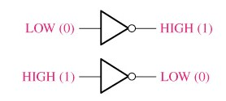
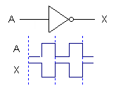
Inverter(NOT gate)

 Output of an inverter is opposite/complement of its input.
Truth table
Boolean expression
0 = LOW
1 = HIGH
When the input is LOW, the output
is HIGH
When the input is HIGH, the output is LOW
Pulsed waveforms
5

Slide 5

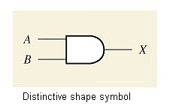



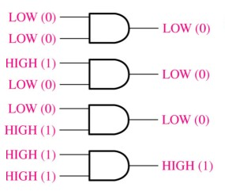
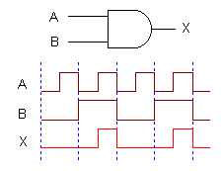
AND Gate

The output of an AND gate is HIGH only when all inputs are HIGH and LOW when any input is LOW.
Boolean expression
Truth
table
0 = LOW
1 = HIGH
N =2^{𝒏}
Pulsed
waveforms
6

Slide 6
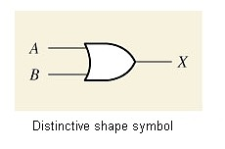



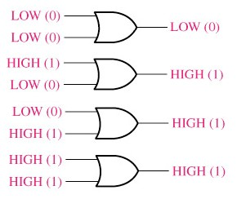
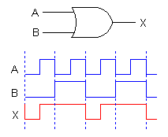

The OR Gate
The output of an OR gate is HIGH whenever one or more inputs are HIGH and Low when all inputs are LOW
N=2^{𝑛}


Boolean expression
Truth table
0 = LOW
Pulsed waveforms
1 = HIGH
7

Slide 7
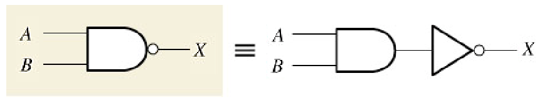
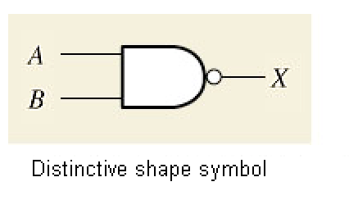




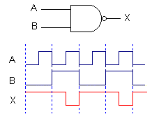
The NAND Gate

The output of a NAND gate is HIGH whenever one or more inputs are LOW.
Boolean expression
Truth table
0 = LOW
1 = HIGH
Pulsed waveforms
8

Slide 8

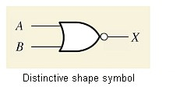


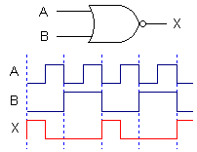
The NOR Gate

The output of a NOR gate is LOW whenever one or more inputs are HIGH.
Boolean
expression
Truth table
0 = LOW
Pulsed waveforms
1 = HIGH
9

Slide 9
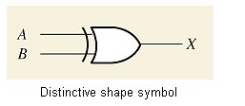


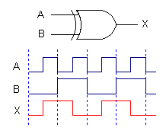


Exclusive-OR
The output of an XOR gate is HIGH
whenever the two inputs are different.

Boolean
expression
Truth table
0 = LOW
Pulsed waveforms
1 = HIGH
The output of an XOR gate is HIGH when there are
ODD number of 1’s on the inputs to the gate
10

Slide 10


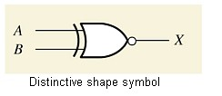


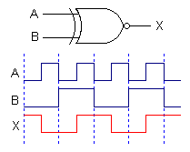





Exclusive-NOR Gate

The output of an EX-NOR gate is HIGH whenever the two inputs are identical.
Boolean expression
Truth table
0 = LOW
Pulsed waveforms
1 = HIGH
The output of an EX-NOR gate is HIGH when there are EVEN number of 1’s on the inputs to the gate except when all its inputs are “LOW”.
11

Slide 11



Slide 12
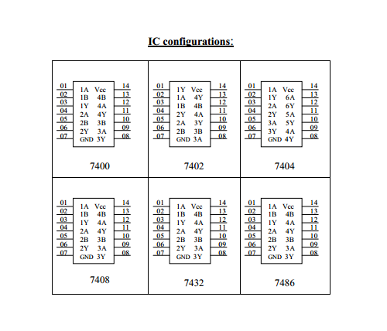
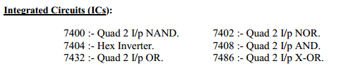


Slide 13
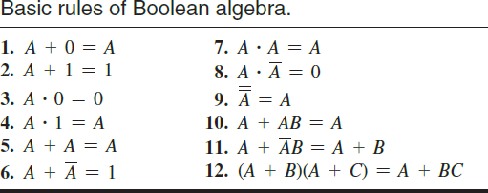

Slide 14
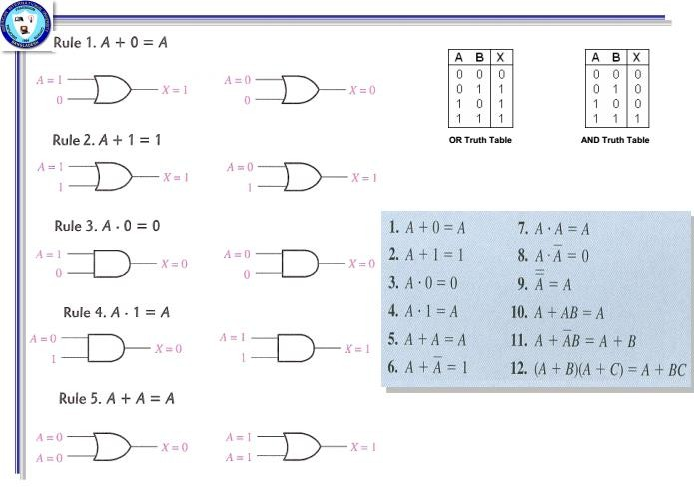

Slide 15
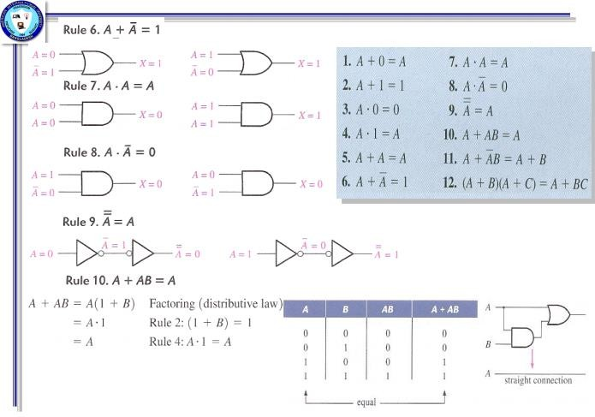

Slide 16
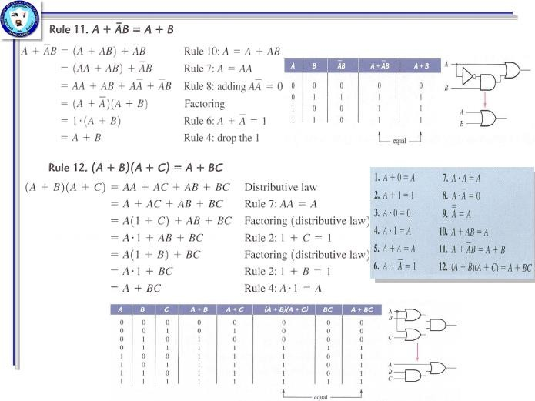

Slide 17
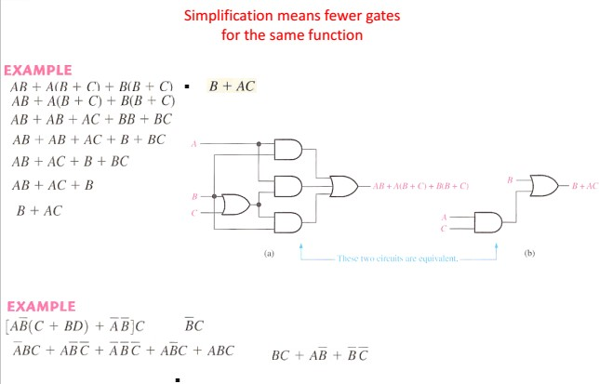
Simplification using boolean algebra

Slide 18


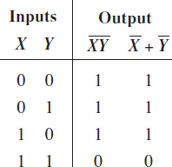
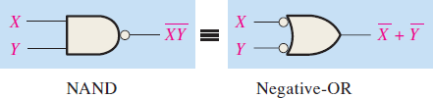
The first theorem is stated as follows:
The complement of a product of variables is equal to the sum of the complements
of complements of the variable.
The formula of this theorem for two variables is written as
𝐗𝐘 = 𝐗 + 𝐘

Slide 19
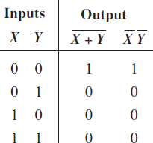
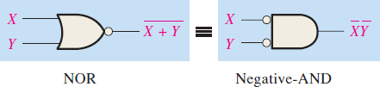
The second theorem is stated as follows:
The complement of a sum of variables is equal to the product of the complements
of the variables.
The formula of this theorem for two variables is written as
𝐗 + 𝐘 = 𝐗𝐘

Slide 20





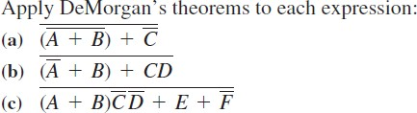
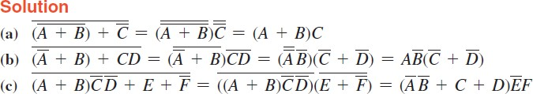


Slide 21

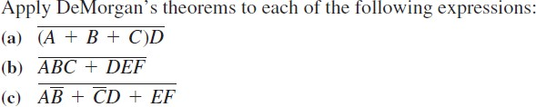


Slide 22
Textbooks:

 [1] Thomas L. Floyd, “Digital Fundamentals” 11th
edition, Prentice Hall.
 [2] M. Morris Mano, “Digital Logic & Computer Design” Prentice Hall.

